Slide 1
Electromagnetism

Slide 2
Brain Pop
Induction: https://www.brainpop.com/technology/energytechnology/electromagneticinduction/
Electromagnetism: https://www.brainpop.com/science/energy/electromagnets/

Slide 3
Electromagnetism
An electric current that produces a magnetic field
Electromagnets
A solenoid with an ferromagnetic core
A strong magnet that can be turned on and off

Slide 4
Solenoid
A coil of wire with an electrical current.
Characteristics
Can be turned on and off
Can have its direction reversed
Can have its strength changed
Their ends act like magnetic poles

Slide 5
Creating a Larger Electromagnet
Coils
Each loop of coil has a small amount of magnetic pull
When the loops are added together the coil begins to act as a magnet with poles

Slide 6
Characteristics
Field can be turned on or off
Its direction can be reversed
The strength of the field can be changed

Slide 7
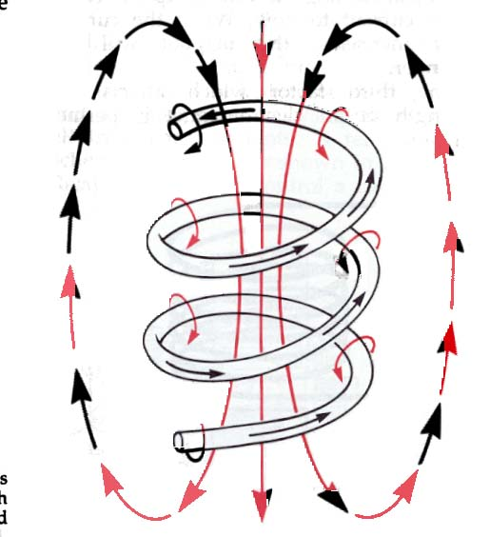
Electromagnetic Field

Slide 8
Strength of Electromagnets
Depends on three main things:
Number of turns in the coil
The more turns in a coil, the stronger the magnet
Amount of current in the coil
If the voltage is increased, so will the current, which increases the strength of the magnetic field

Slide 9
Strength of Electromagnets(cont.)
Permeability of the core material
Permeability: The ability of a material to be magnetized, even temporarily, and to transmit magnetic force
Air would make a weak magnet
Iron would make a strong magnet

Slide 10
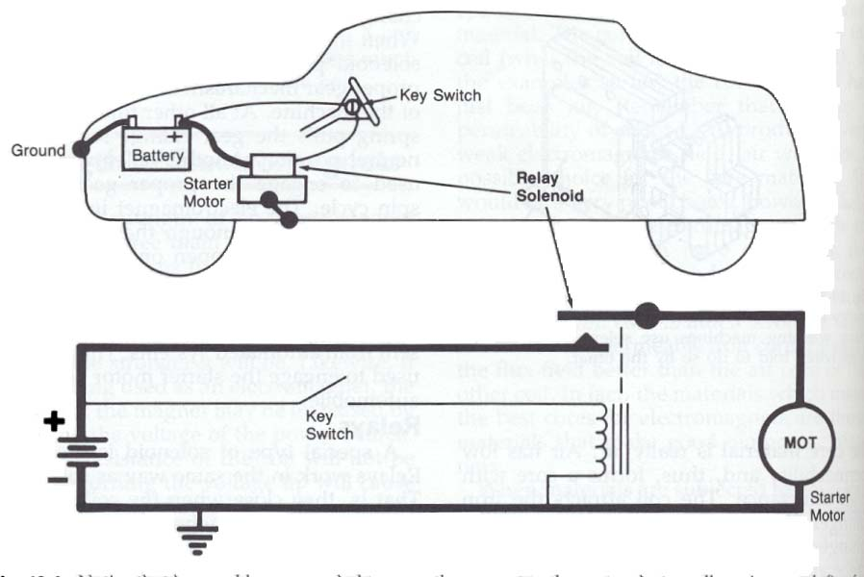
Solenoid Uses

Slide 11
Other uses for Electromagnets
Transformers
Industry
Sensors
Motors

Slide 12
Electromagnetism Lab
Create an electromagnet using the materials provided
Before creating the EM, attempt to use the iron nail as a magnet.
After creating the EM attempt to make it stronger/ pick up more paper clips.
Create a motor using the materials provided

Slide 13
Conclusion
What happened when you put the nail near the paper clip before creating the EM ?
What is a coil of a wire called?
What happened when you put the nail near the paper clips after creating the EM?
What makes the nail magnetic?
Based on your observations how can you increase the strength of an electromagnet?
Why was the motor able to work?
How is it similar to the EM?
Place the electromagnets in order from strongest to weakest. Use numbers 1 (strongest) through 4 (weakest)
__________ 6 volt battery, 30 loops of wire, iron core
__________ 3 volt battery, 15 loops of wire, iron core
__________ 3 volt battery, 30 loops of wire, iron core
__________ 9 volt battery, 30 loops of wire, iron core
How did you know to put them in this order?

